Slide 1

Supercharging Development with AI
Vibe Coding
Workflow
Presented by 鄭庭安
Tingan Cheng
NYCU 機械系
學號：110611103

Slide 2

Tip 1: Embrace YOLO Mode
Trust AI to generate working code from your intent.
Let go of early control
to move fast.
Note:
Set up an allowlist and a blocklist to balance freedom and safety.

Slide 3

Tip 2:
Write a Detailed Product Spec.
Use divide and conquer :
Split vision into small,
well-scoped tasks.
Clearly define file scope for precise AI edits.
Note:
Update spec. as you go.
Name key unit so AI can
reference them consistently.

Slide 4
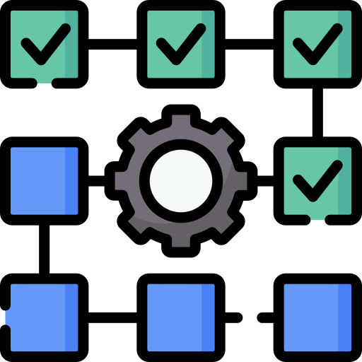
Tip 3: Step-by-Step Changes + Unit Tests
Ask AI for incremental changes
Request unit tests to
validate new features
Note:
Catch issues early and ensures changes don’t break existing logic.

Slide 5

Tip 4: Use Git for Safe Progress
Version control
==
Peace of mind
Commit good versions regularly.
Let AI experiment freely without risking stable code.
Note:
Always allows safe rollback
or branching.

Slide 6

Thank You for Your Attention!
Let AI help you vibe, build, and iterate faster.

